Slide 1
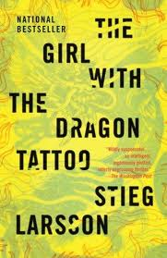
Book of the Week: The Girl with the Dragon Tattoo
*Spoiler Alert*
i
Originally written in Swedish, The Girl with the Dragon Tattoo follows Lisbeth Salander and Mikael Blomkvist. Blomkvist is a reporter and editor for Millennium (a magazine for which he is also co-founder). He is convicted for libel and believes his career in journalism to be over.
More to come tomorrow!

Slide 2
Book of the Week: The Girl with the Dragon Tattoo
*Spoiler Alert*
i
Even though Blomkvist thinks his career is over, the head of the Vanger family asks Blomkvist to investigate the murder of Harriet Vanger. Persistent asking and a promise of immense recompense persuade Blomkvist to join the battle and investigate, even though he denied to help at first.
Stay tuned!

Slide 3
Book of the Week: The Girl with the Dragon Tattoo
*Spoiler Alert*
i
During his investigation, Blomkvist meets a computer hacker: Lisbeth Salander. Together, after facing death, threats, and murder attempts, they solve the mystery of Harriet Vanger’s murder.
More to come tomorrow!

Slide 4
Book of the Week: The Girl with the Dragon Tattoo
i
The Girl with the Dragon Tattoo is an amazing thriller and mystery. Even at a whopping 644 pages in paperback, this book is completely worth reading. It is the first in a trilogy, and there are also movies based on the books.

